Slide 1

GLOBAL FOOD PRICES - MIDTERM PROJECT
Collaborative effort
-Shruti Kijbile AND Joline Duong

Slide 2
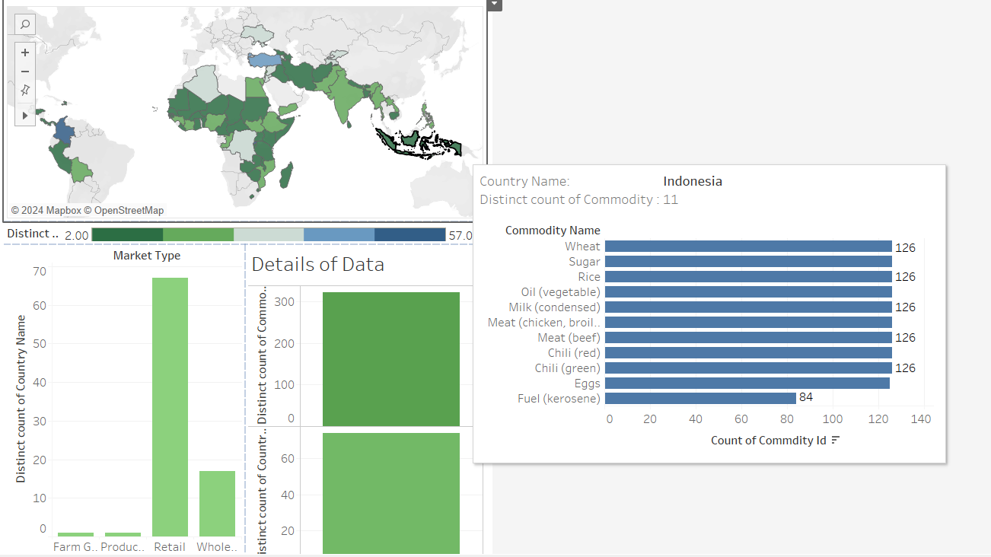
Introduction to data

Slide 3

What we where looking for in the data??
1) The trend in change of price for various commodities in the different countries
2) To see if there change in commodity price within the various regions within the same country ?

Slide 4
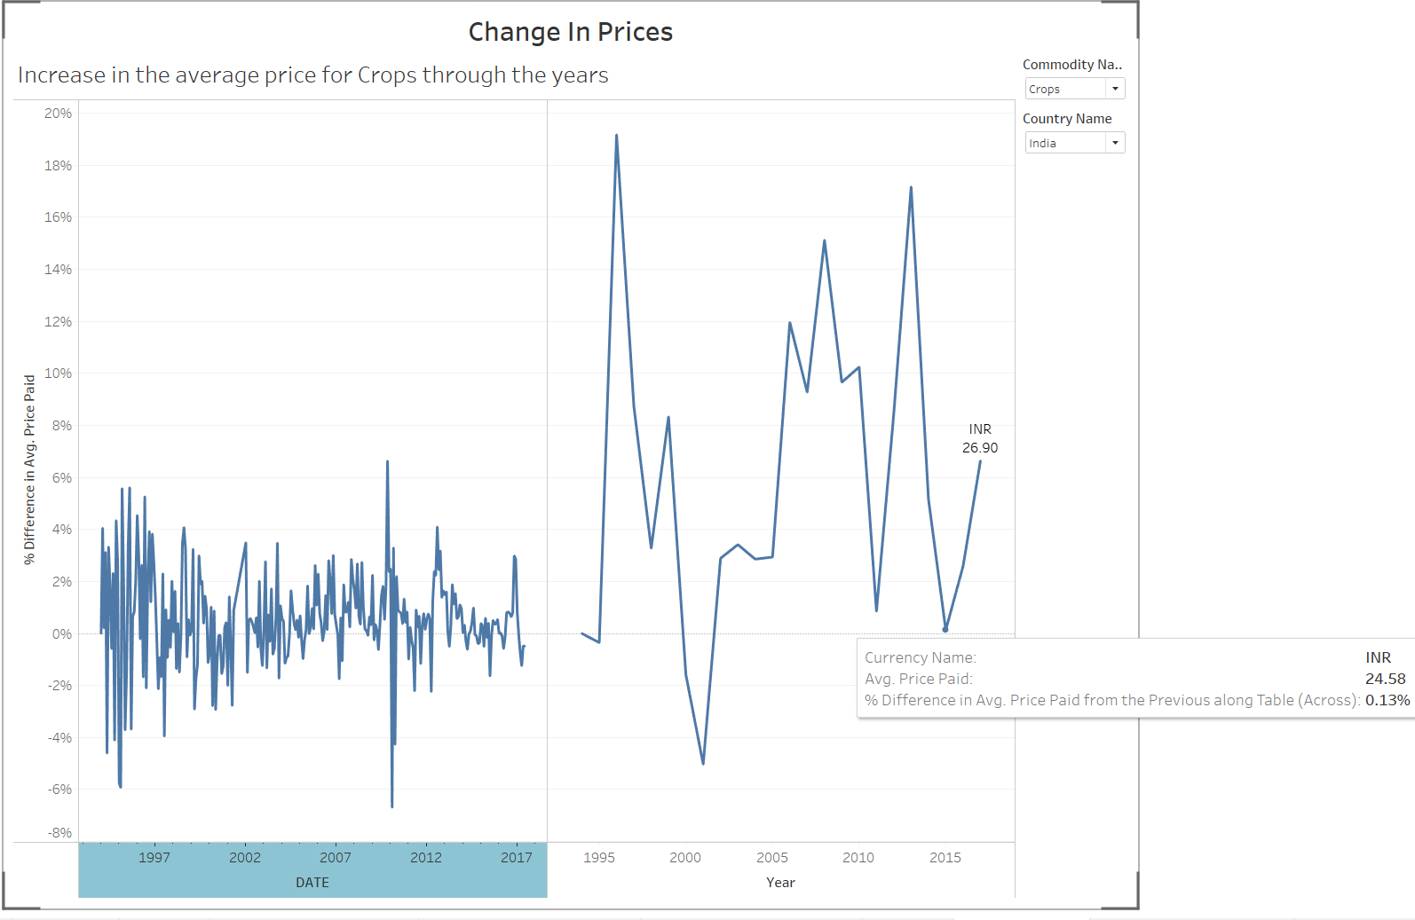
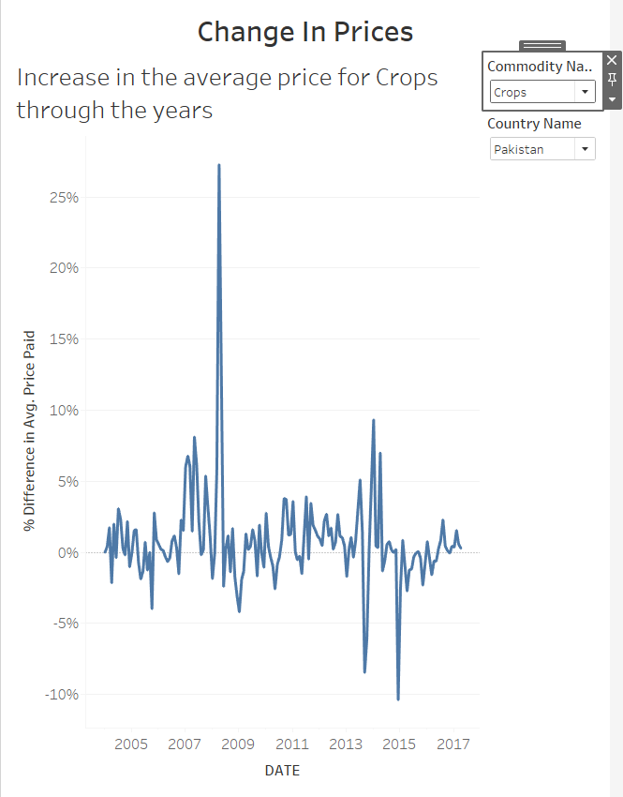
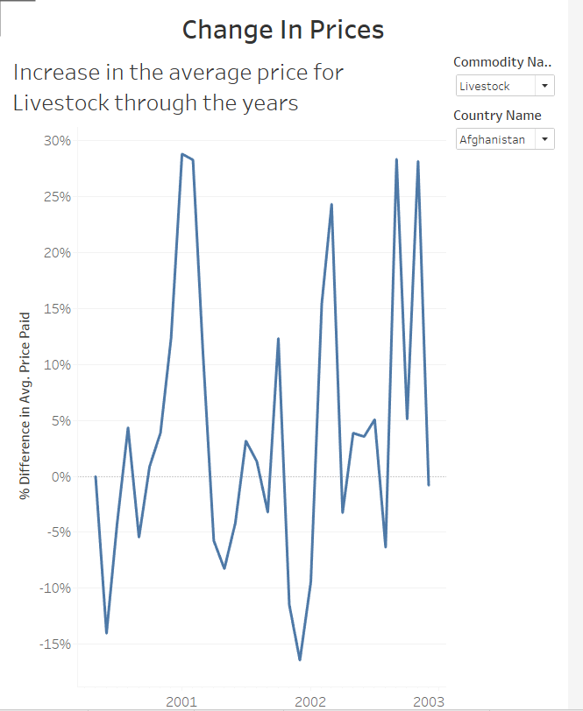

Slide 5
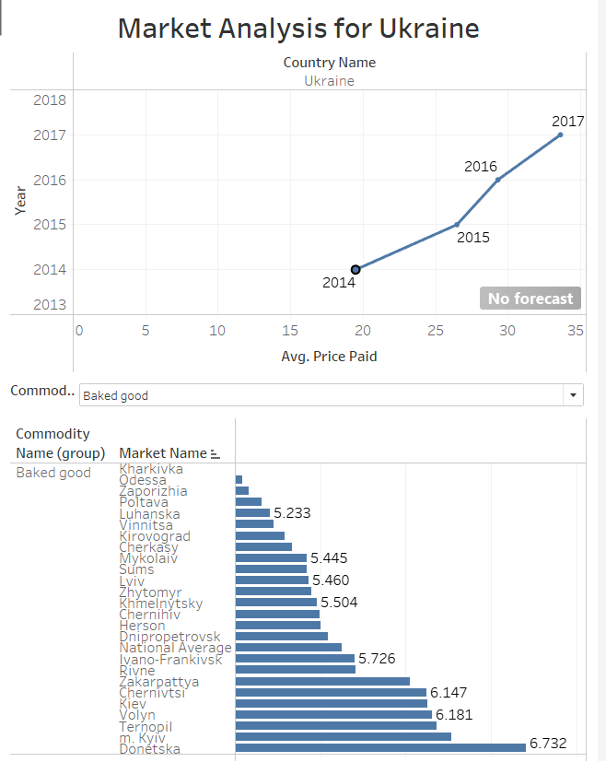
Observations
Average price increases through the years.
The war started in 2014 but there is not enough data points to prove its affect.
Different markets have varying cost.

Slide 6
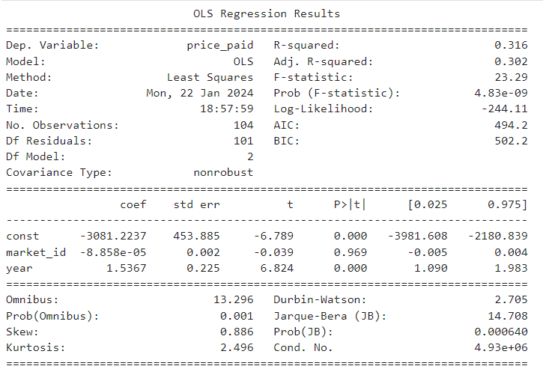
Statistical Modeling filter-Ukraine
A lot of our data was categorical
Linear regression model was weak
Year had the most significant correlation

Slide 7
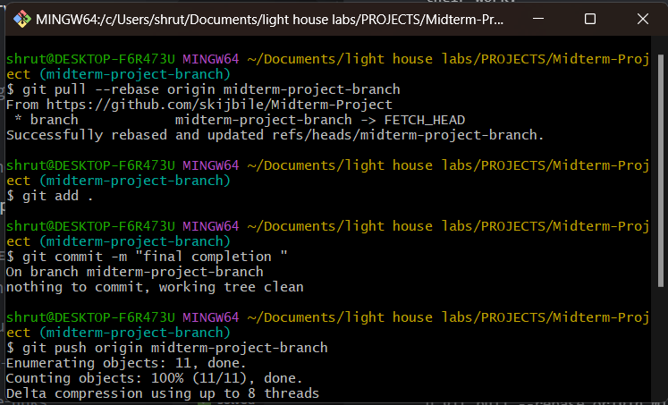
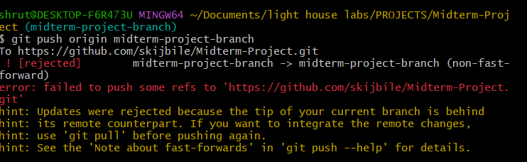
Challenges!!!
Time coordination with partner
Finding data that was interesting for both of us
Pushing data to remote repository

Slide 8
If there was more time !!
We would have explored the data more.... Many aspects left unturned.
Implemented better communication and coordination to study the data deeper.

Slide 9

Thankyou !! Good Night!!

